Slide 1
Methods of Face Recognition
Jakob Horbank

Slide 2
Overview
Introduction
Requirements
Challenges
Face Detection
Viola-Jones face detection
Histogram of gradients
Face Alignment
Landmark localization
Face Recognition
General approach
Eigenfaces
Neural network approaches
Summary

Slide 3
Introduction
“Given still or video images of a scene, identify or verify one or more persons in the scene using a stored database of faces”
Applications
Security
Law Enforcement
Entertainment

Slide 4
Requirements
Video recognition demands realtime computation
Recognition has to be fast
Security applications need very high precision
Very low error rate, especially false positives
Not all image sources can guarantee good input quality
Has to be reliable even when faces are partly occluded

Slide 5
Challenges for Face Recognition
Occluded faces
Groups of people
Bad image quality
Low resolution
Different lighting
Huge variation in the looks of people
Beards, Piercings, Tattoos, Glasses
Pose
Color, Ethnicity

Slide 6
face recognition SYSTEM
The actual face recognition is part of a bigger face recognition system
Such a system is generally divided into 3 steps
Face detection
Face alignment
Face recogntion

Slide 7
Face Detection

Slide 8
Face Detection
Goal
Locate face in image
Seperate face from background
Different approaches
Feature-based
Based on our face knowledge
Handcrafted Filters
Image-based
Algorithms trained directly from image data

Slide 9
Viola-Jones face detection
Major breakthrough because realtime usage was possible
Uses a cascade of very simple rectangle Features
Fast computation enabled by new image representation

Slide 10
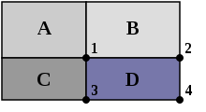

Viola-Jones face detection
Simple Haar-like rectangle features that compute the difference of pixels sums
The integral image where every pixel value is the sum of all pixels left and above
$$D=4 +1 −(2+3)$$

Slide 11
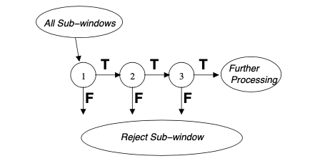
Feature cascade
A cascade of feature classifiers gets created through a boosting algorithm
The best features are applied first to throw out most non-faces early
If all filters are passed we detect a face

Slide 12
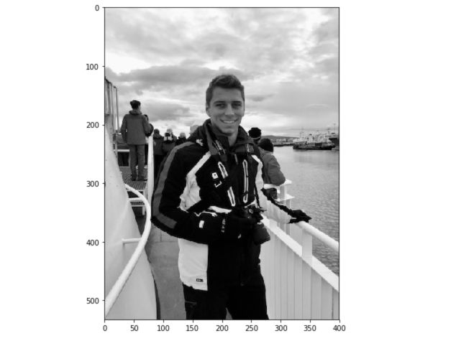
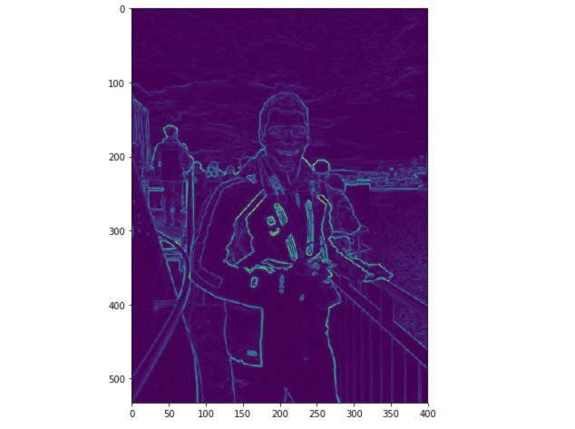
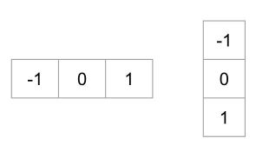

HOG - Histrogramm of gradients
We build a vector from the distribution of gradients in the image
This vector is then fed into a trained classifying algorithm
The first step is to calculate the gradients
Apply simple filters to the image
$$∗$$

Slide 13
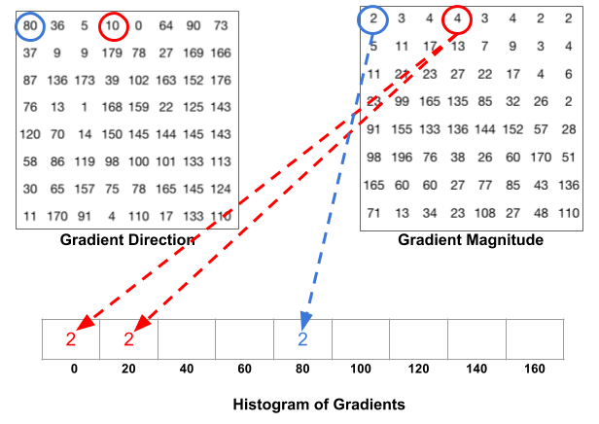
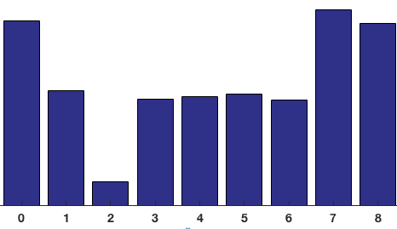
HOG - Histrogramm of gradients
We devide the image into 8x8 cells to decrease sensitivity to noise
For each cell we build the Histogram of Gradients
We receive a histogram which we can use as a feature vector

Slide 14
Histogram of gradients
After that we normalize the concatenated vectors of 16x16 blocks
This reduces sensitvity to different lighting circumstances
Now we can feed the created feature vector into a trained classifier
For example, a SVM could be used
Faster than Viola-Jones algorithm while having similar accuracy

Slide 15
Alignment

Slide 16
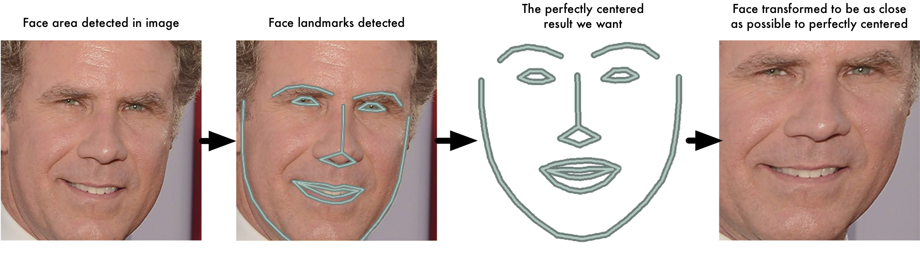
Face Aligment
For better results in later steps, the faces should be aligned
Detect a set of facial landmarks, then apply simple image transformation
Translation
Rotation
Scaling
Shearing

Slide 17
Landmark Detection
The face shape is composed out of a set of landmarks
Algorithms try to align these landmarks as close as possible
Once aligned, different parts of the face can be extracted
Used in face morphing apps

Slide 18
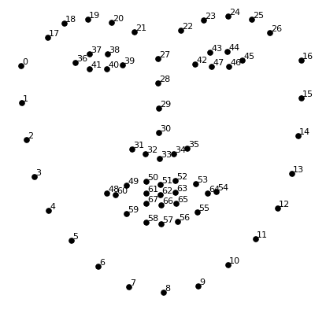
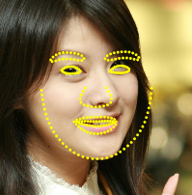
Landmark detection
The previous detection step yielded us the face position
We start by centering the mean shape inside the detected bounding box

Slide 19
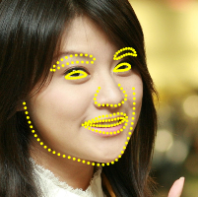
Landmark detection
Run through a set of trained regression trees
The trees decide how each landmark gets translated
With each step the true shape gets estimated better
Set of regression trees
Landmark translation vector

Slide 20
Landmark detection
On every split, the trees compare the difference of 2 pixels to a threshold
p2 – p1 > threshold?
yes
no
p1
…
…
p2
Landmark translation vector

Slide 21
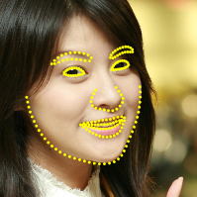
Landmark detection
By default the algorithm goes through 10 stages
Each stage uses different regression trees
Different pixels are compared
Different thresholds are used
Stage 1
Stage 2
Stage 10
…

Slide 22
FACE Recognition

Slide 23
Face Recognition
Most difficult step in the system
Main modes of face recognition
Face verification (Is this the person?)
Face identification (Who is this person?)
How can we compare faces?
→ Face Embeddings!

Slide 24
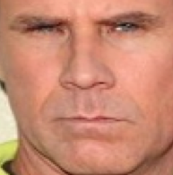

Face Embedding
Just comparing the pixel values won‘t work
How many comparisons?
Unessary information
Some type of feature extraction is needed
Which features to choose?
The obvious features (eyes, nose, …) aren‘t ideal
let the algorithm choose
N*N
M << N*N
Recognition Algorithm
$$[x_{1},x_{2},…]$$
Feature vector

Slide 25
Face Embedding
The faces get embedded in a feature space
Verification → Distance to face vector under a threshold?
Identification → Which face vectors are closest?
These are simple problems to solve
k-Nearest-Neighbours
SVM classifier

Slide 26
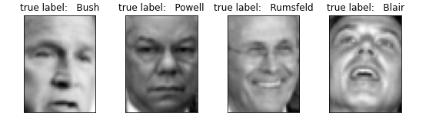
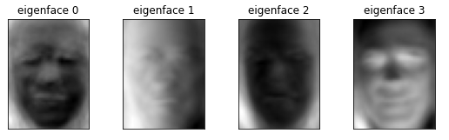
Eigenfaces
One of the earlist attempts (1991)
A set of eigenfaces is generated for a set of training faces
This is done with Principal Component Analysis
Reduction of dimension while preserving most information
PCA

Slide 27

Eigenfaces
We represent every face with a linear combinatiton of eigenfaces:
$${face}_{1}= x_{1}∗{eigenface}_{1}+x_{2} ∗{eigenface}_{2}+…+x_{n} ∗{eigenface}_{n}$$
$$\left[\begin{matrix}x_{1} \\ x_{2} \\ ⋮ \\ x_{n}\end{matrix}\right]$$
Then we can extract our feature vector:
This method was a first step, but isn‘t accurate enough for production use
Sensitive too brightness
Faces need to be very straight and upfront

Slide 28
Convultional Neural Networks
All state-of-the art methods make use of CNNs (Convolutional Neural Networks)
There are lots of different architectures of CNNs used
In 2016, „FaceNet“ was introduced
CNN learns a direct embedding from image to feature space
Usage of a triplet loss function
Accuracy of over 99% on widely used dataset

Slide 29



FaceNet
There is no layer inbetween the face image and the feature embedding
In older methods this layer could serve as a bottleneck
$$220∗220∗3$$
$$1∗1∗128$$
CNN
$$[x_{1},x_{2},…]$$

Slide 30




FACENET
On each layer the dimension gets reduced by a convolution or pooling process
$$220∗220∗3$$
$$110∗110∗64$$
$$…$$
weights
weights
weights
$$1∗1∗128$$
Adjust according to error function

Slide 31
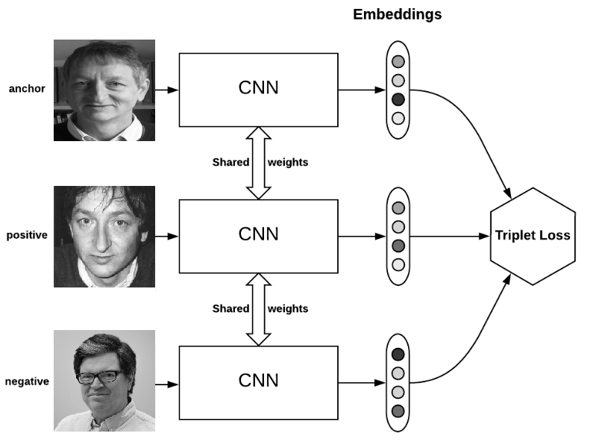
TRIPLET LOSS
A loss function that factors in positive and negativ examples
Goal:
Minimize distance between anchor and postive
Maximize distance betweem anchor and negative
The triplet loss is used to adjust the CNN

Slide 32
Summary
A face is recognized in certain steps
Detect
Align
Recognize
While we can‘t detect and align pretty good reliable recognized is still very hard to do
All state-of-the art approaches make use of Neural network algorithms

